Slide 1

Closures in JS

Slide 2



What is Closures ?
When a function is defined inside another function, it creates a closure.

Slide 3

The inner function retains access to the outer function's variables, forming a link to its lexical scope.

Slide 4
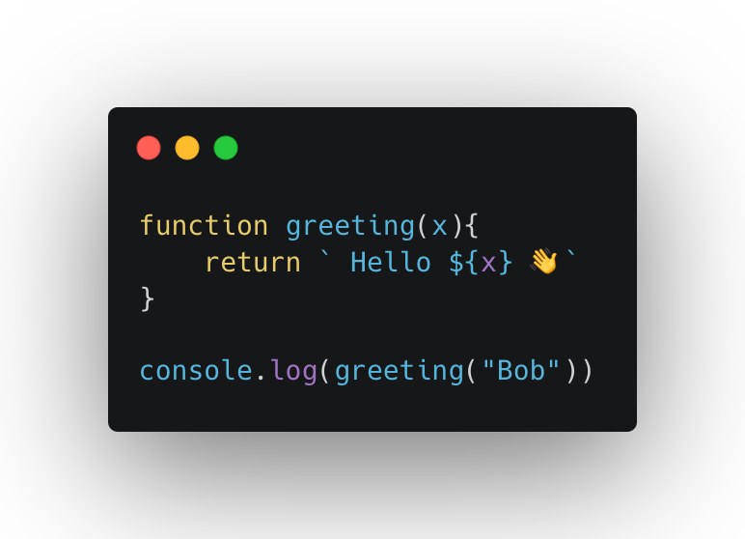
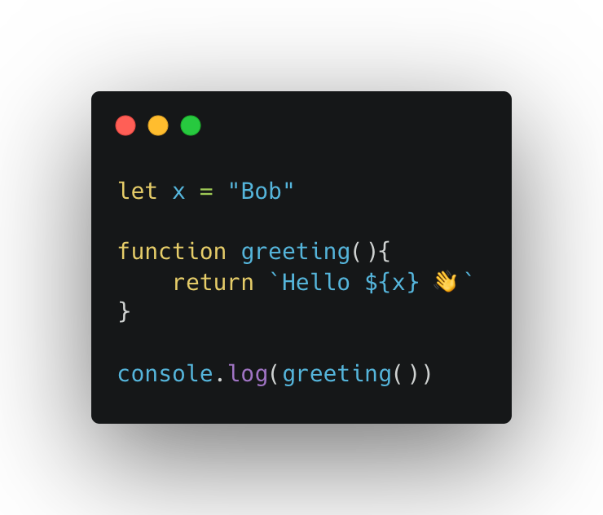
PURE FUNCTION
IMPURE FUNCTION

Slide 5


CALL STACK
HEAP MEMORY
Impure functions / closure
Pure functions
Long Lived
Short lived
More computation
More memory

Slide 6
